Slide 1



Slide 2
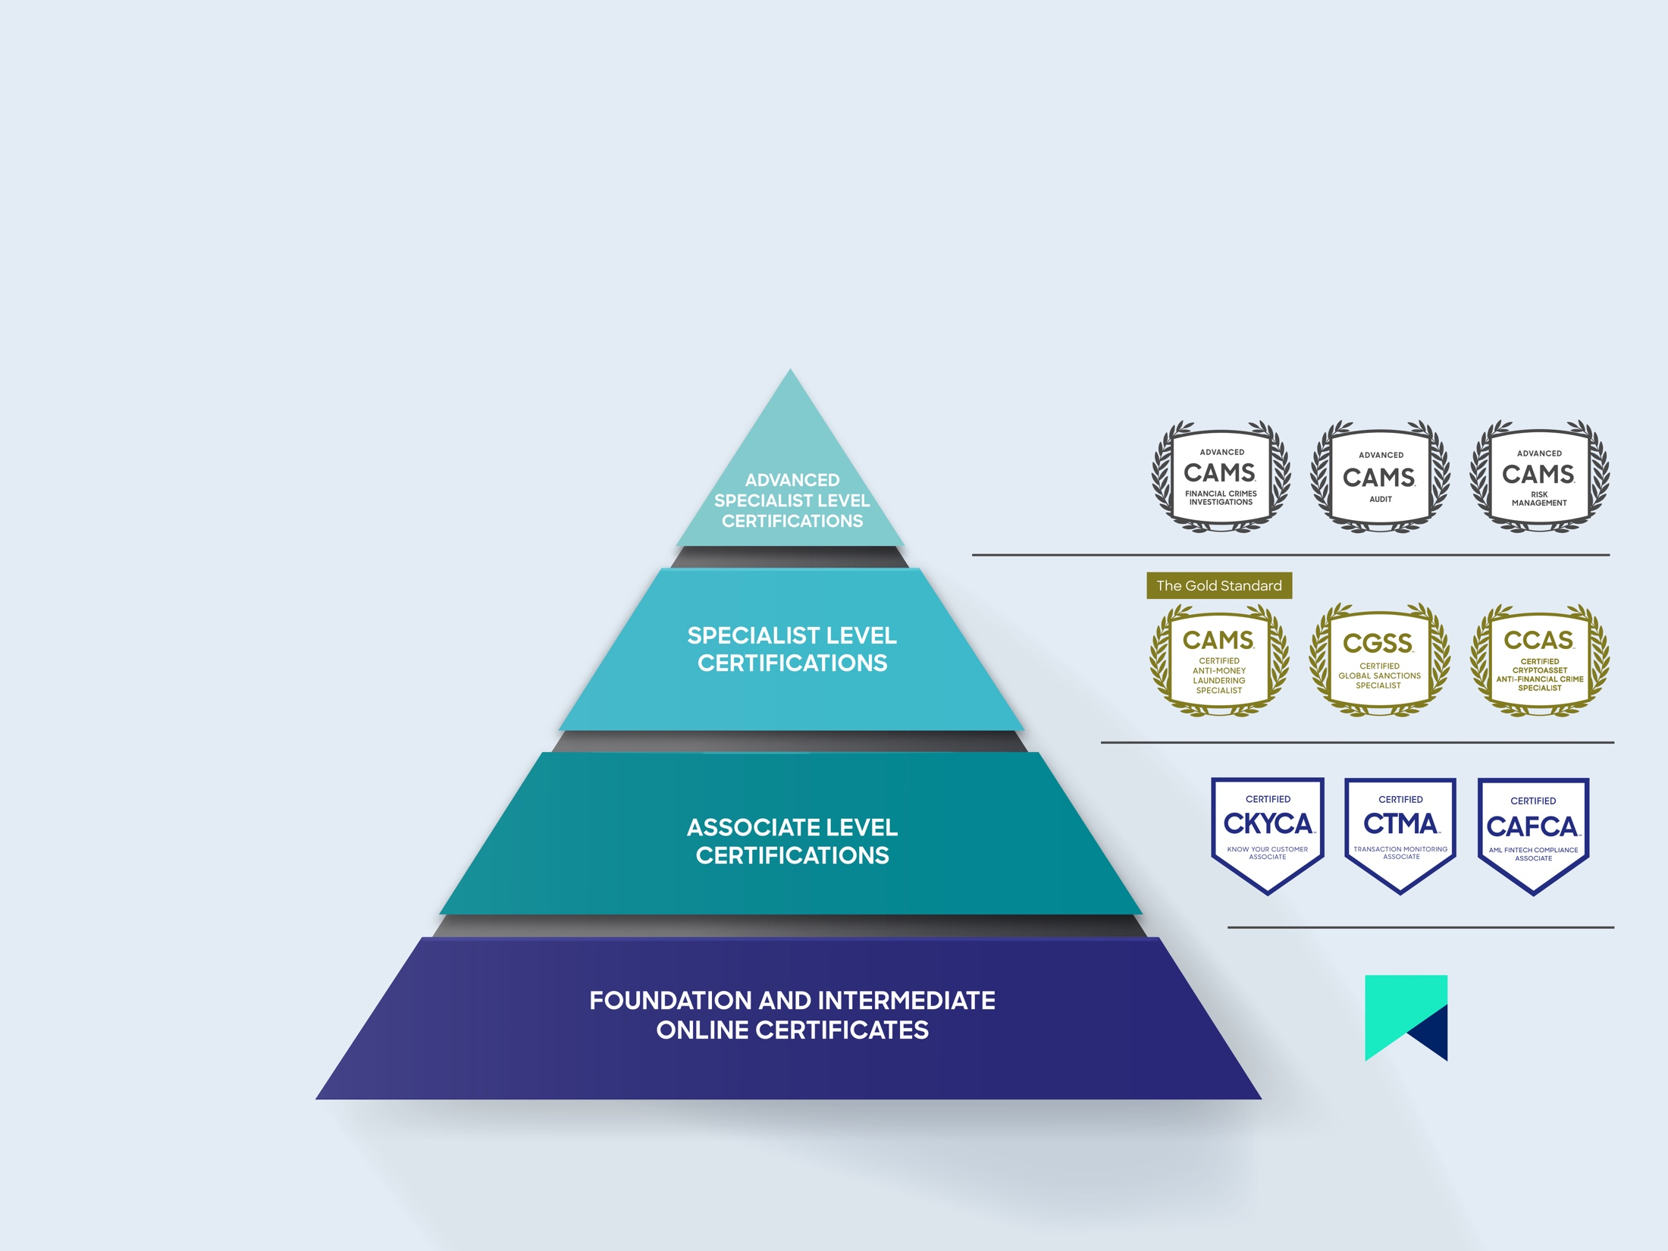
TRAINING ECOSYSTEM
Our world-class training
and accreditation
programs help global
organizations stay ahead
of financial crime - now
and in the future.
www.acams.org
©2022 ACAMS. All Rights Reserved.

Slide 3

Clear. Credible. Comprehensive
VISION:
To offer financial institutions worldwide a standardized means of measuring, understanding, and explaining their money laundering risks, through global standardization, helping FIs of all sizes meet their regulatory challenges.
Now for MSBs too
Book a free demo at
www.acamsriskassessment.com

Slide 4

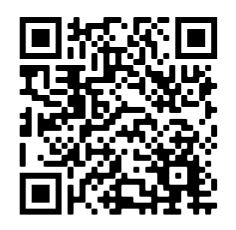
Your all-access pass to ACAMS’
upcoming and on-demand webinars
9+
NEW live webinars
released each month
on average
40+
AFC topics covered
each year
800+
Hours of AFC training
in the ACAMS library
Discover an abundance of content spanning the
breadth of financial crime prevention topics, including
all ACAMS Sanctions webinars.
Available now
acams.org

Slide 5
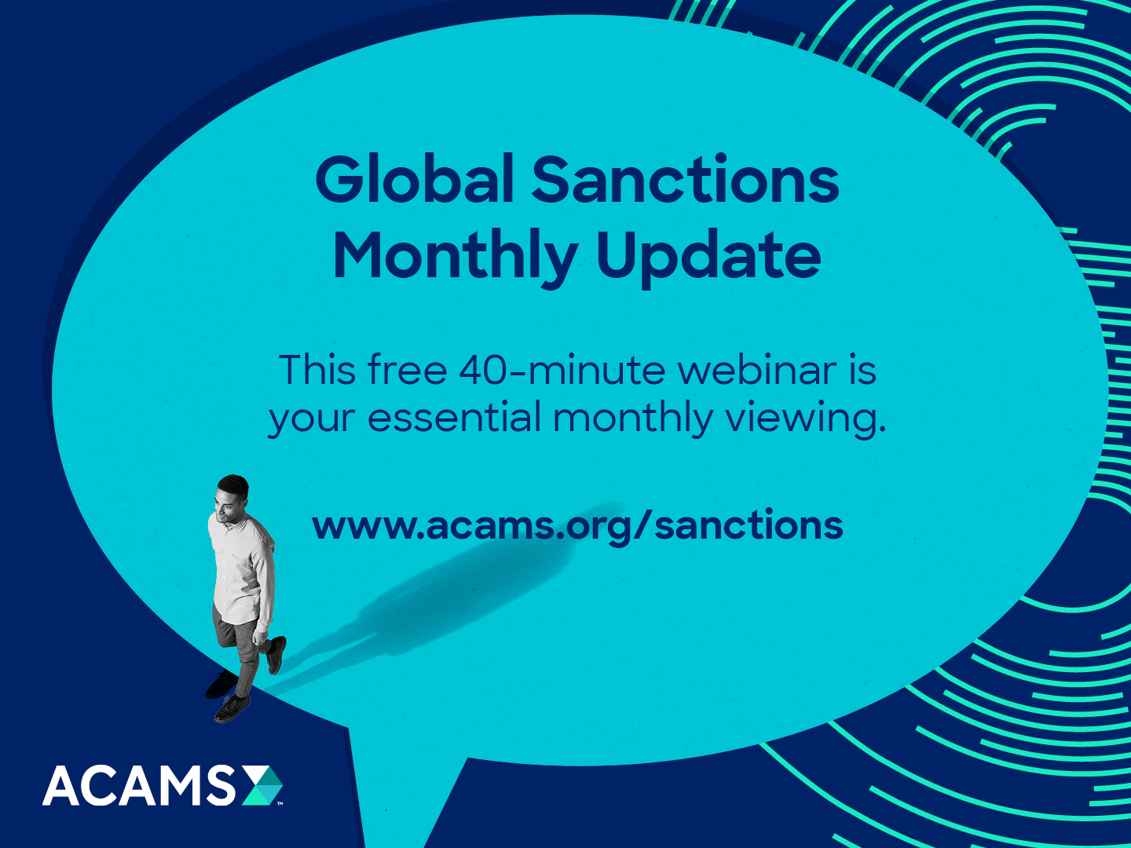

Slide 6
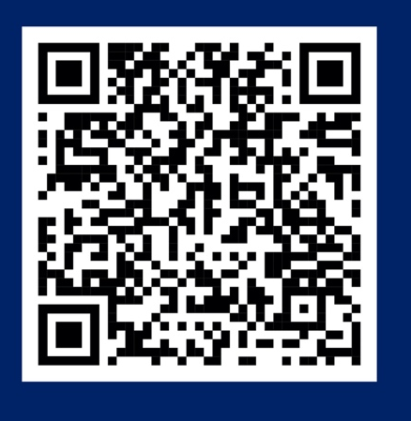
Social-Impacting Certificate (free):
Ending Illegal Wildlife Trade –
A Comprehensive Overview
Learn how to identify, report, mitigate and remedy
the risks associated with each stage of the illegal wildlife trafficking.
Self-paced
Content split into four learning sections
20–questions final assessment
Two ACAMS credits

